Slide 1
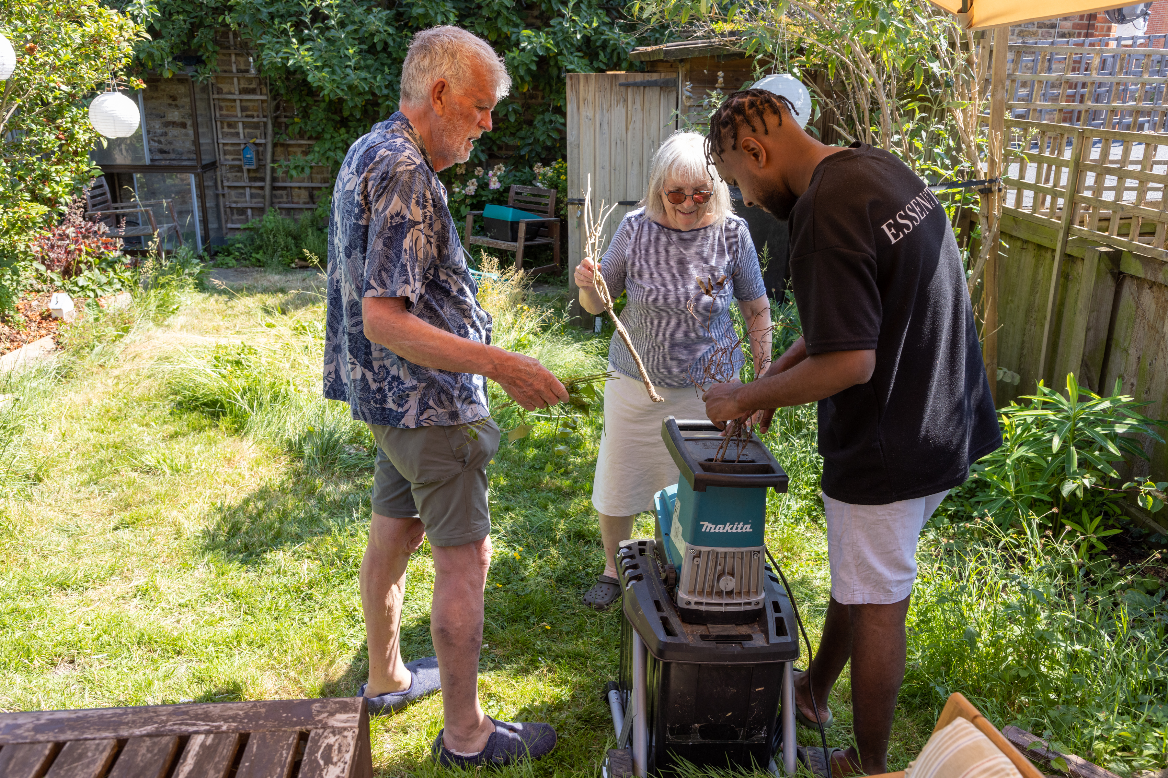
Information session - hosting refugees
www.refugeesathome.org

Slide 2
About Refugees at Home
R@H connects refugees and people seeking asylum, of all nationalities, with hosts across the UK.
The vision is for every refugee and every person seeking asylum to have a safe place to stay.
Hosts decide how long they would like to host for; placements vary from a week to a few months.
www.refugeesathome.org

Slide 3
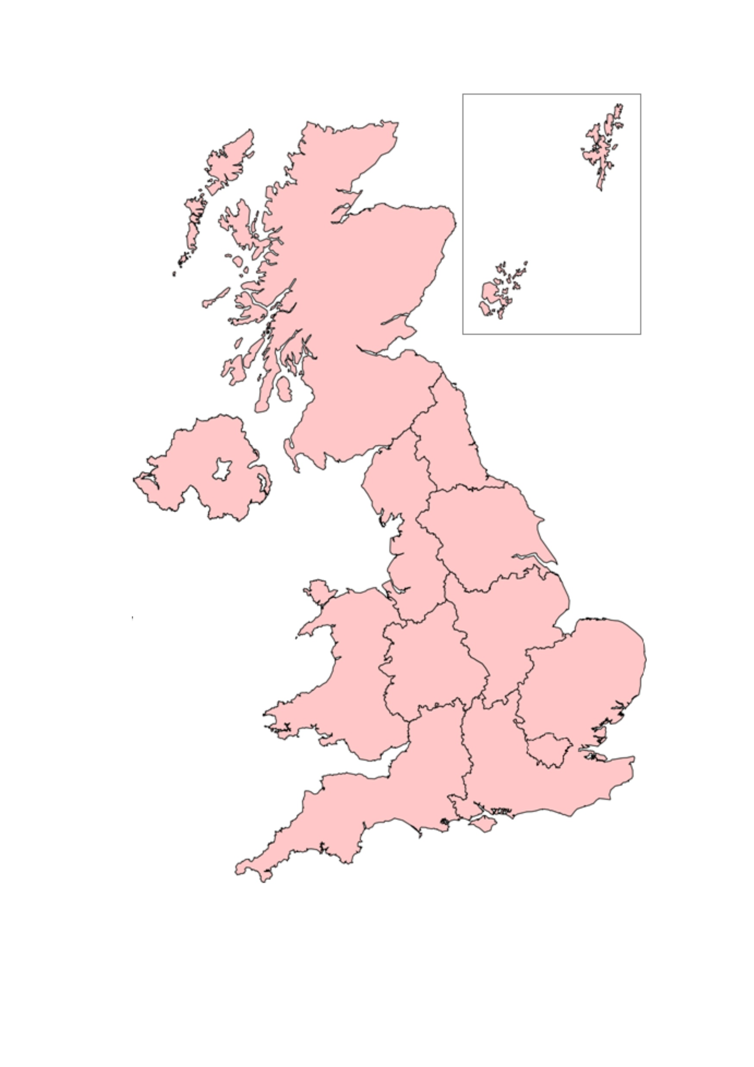
Where is hosting needed?
Refugees at Home is a UK-wide charity that organises hosting in cities and towns across the country.
Hosts need to be well connected with good affordable transport links. This enables guests to travel to college, school, support groups or jobs, and retain their independence.
www.refugeesathome.org

Slide 4
Who can be a host?
People willing to give a safe space to a refugee or person seeking asylum as they plan their next steps in the UK
We have a higher demand for hosts in cities and large towns across the UK
Individuals or families with a spare room (or rooms!) in their home
www.refugeesathome.org

Slide 5
Becoming a Host: How does it work?
Placement team approach with guest
Home visit & 2 references
Welcome your guest for agreed time-period
Apply online
Approved to host
Refugees at Home will support you through every step of the process
www.refugeesathoe.org
www.refugeesathome.org

Slide 6
Quote from a previous host:
“I cannot praise Refugees at Home highly enough. The home visitor was very thorough, the family we hosted were a very good match. We and our guests all received attentive support and advice throughout the process.”
www.refugeesathome.org

Slide 7
Who can be Refugees at Home guest?
People with refugee status:
People with positive asylum claims
Respite hosting for training/courses
People who have arrived through resettlement schemes and have no support
People still awaiting the outcome of the asylum process without statutory support:
E.g. People with refused asylum claims who are working with a caseworker
People awaiting a voluntary return
Homes for Ukraine scheme:
Those arriving through the government’s Homes for Ukraine scheme (6 months of hosting)
www.refugeesathome.org
www.refugeesathome.org

Slide 8
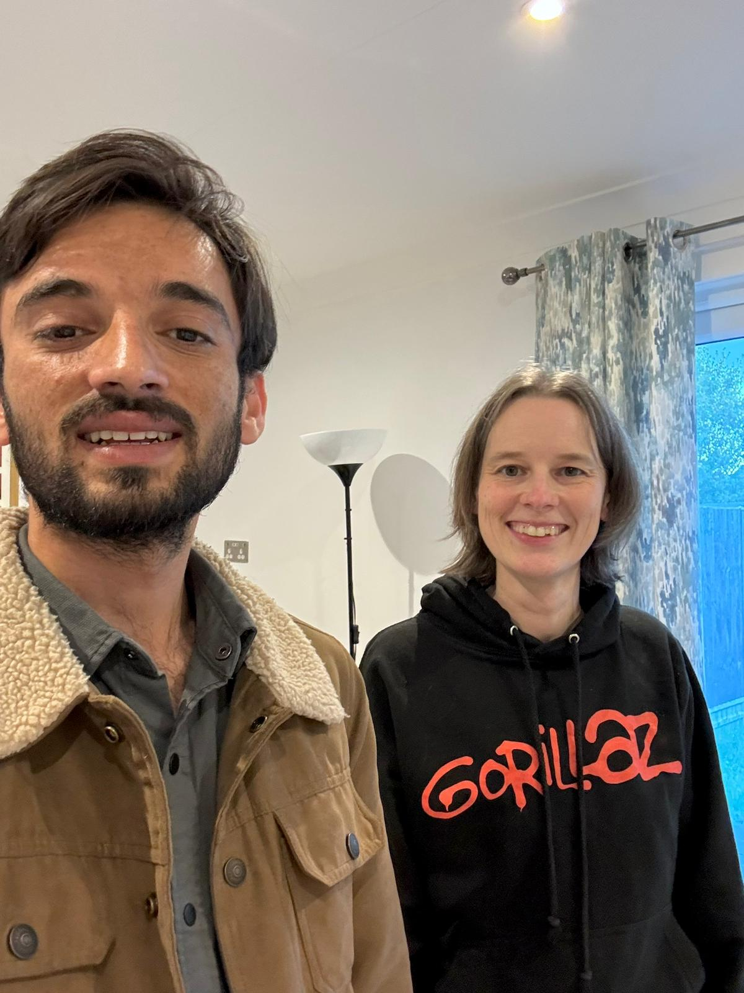
"Living in a state of uncertainty and facing numerous challenges, I could not have imagined the immense impact that my stay would have on my overall well-being.
Not only have I had the chance to find a warm and welcoming home, but I have also been able to recover financially, thanks to your invaluable help.”
Irfan, guest of Clare
www.refugeesathome.org
www.refugeesathome.org

Slide 9
Case study: Hosts Andrew & Jane

Slide 10
Why did you initially want to start hosting?
When the kids left home, we thought, well, we can either downsize, or we could take the opportunity of having spare rooms in the house and open our house and our family up to some other people.
The joy of it is the possibility of meeting people from different parts of the world and having people of different cultures bringing their experiences and sharing them with us, which is just an incredibly enriching thing and a lovely thing to do.
Click here to listen to Andrew
www.refugeesathome.org

Slide 11
What is hosting like?
The kitchen table is a really happy place, where people bring their own traditions and their own skills once they've got the confidence to do that. And we can have lots of storytelling and laughs. Sometimes playing games or whatever. All sorts of things happen around the kitchen table.
www.refugeesathome.org
www.refugeesathome.org

Slide 12
What is hosting like?
Sometimes people come and they’ve got no English at all. Sometimes we have to explain everything in sign language before we establish ways of talking to each other or using Google Translate, like to explain how you flush a toilet in England! It's quite an adventure. But it's a lovely thing to find ways of communicating with people.
www.refugeesathome.org
www.refugeesathome.org

Slide 13
Why should you host?
It is a practical way of supporting refugees and showing solidarity.
Refugees at Home are flexible: you tell the team your availability and preferences, and they work around you.
www.refugeesathome.org

Slide 14
What if you don’t have a spare room but want to help? You could…
Have conversations with friends, family, colleagues about hosting and encourage them to sign up if they have a spare room
Share appeal for hosts on social media or distribute leaflets
Donate to Refugees at Home
www.refugeesathome.org

Slide 15
Next Steps
Explore R@H website
Email R@H with any questions
Take a leaflet, think about hosting and discuss with friends + family
Fill out a host application form on R@H website
www.refugeesathome.org
www.refugeesathome.org

